Slide 1
The Past, Present, and Future of Object Detection
Ross Girshick (FAIR)
in collaboration with
Kaiming He (FAIR), Georgia Gkioxari (FAIR), Tsung-Yi Lin (Google Brain),
Bharath Hariharan (Cornell), and Piotr Dollár (FAIR)
Facebook AI Research

Slide 2
Notes:
I’ve worked on object detection for 10 years
This has included developing models and algorithms before deep learning became popular and after
In this talk, I want to share of some of this experience and my perspective on the past, present, and future of object detection
Let’s start with an informal look at what object detection is, by looking at some images, ground-truth annotations drawn by human labelers, and output from algorithms.

Slide 3
COCO
Dataset
Images
Notes:
Progress on object detection is driven by standardized datasets and evaluation metrics and protocols
The COCO dataset is the most important object detection dataset at the moment
This is an example of a typical COCO image; it’s a scene with a variety of objects

Slide 4
COCO
Dataset
Images
Notes:
Here’s another example that’s very different in nature
It’s a fairly diverse dataset

Slide 5
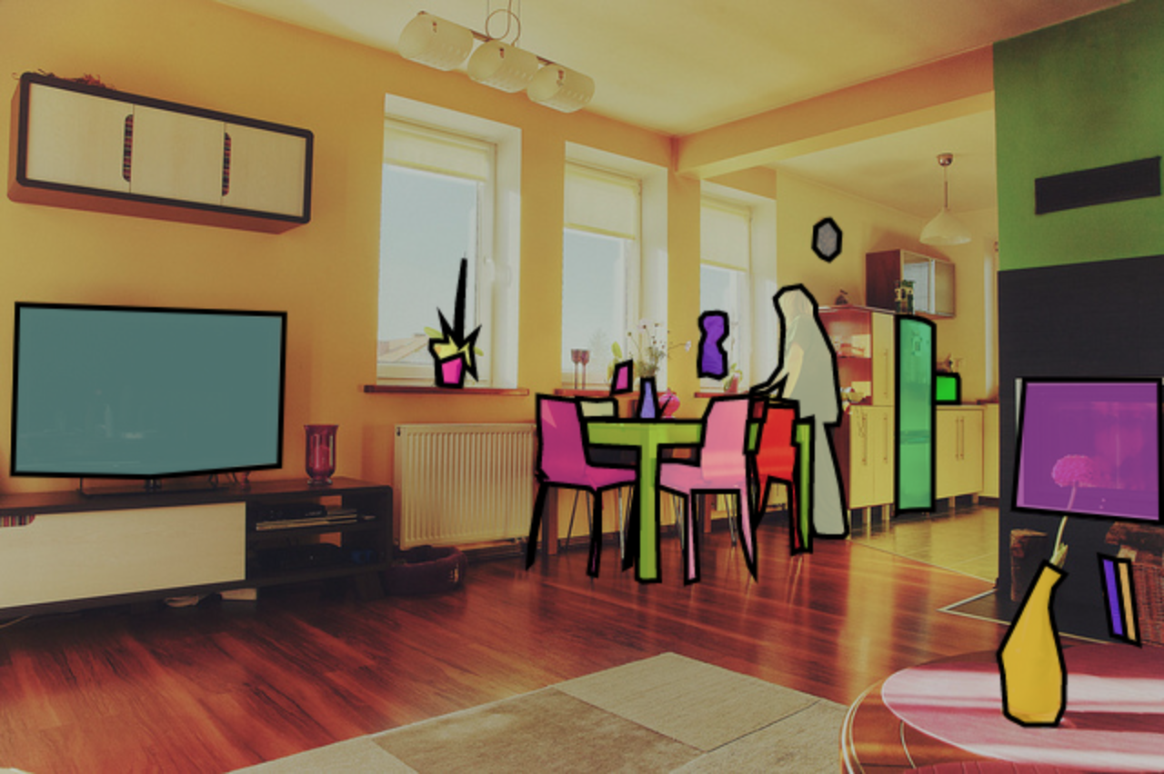
COCO
Annotations
clock
plant
person
person
microwave
vase
vase
tv
chair
vase
table
tv
chair
chair
chair
refridgerator
vase
Notes:
This dataset contains annotations for 80 different categories of objects
Here’s an visualization of the ground-truth labels for the first image
You can see that each instance from the 80 categories is labeled with a polygon mask and a category

Slide 6
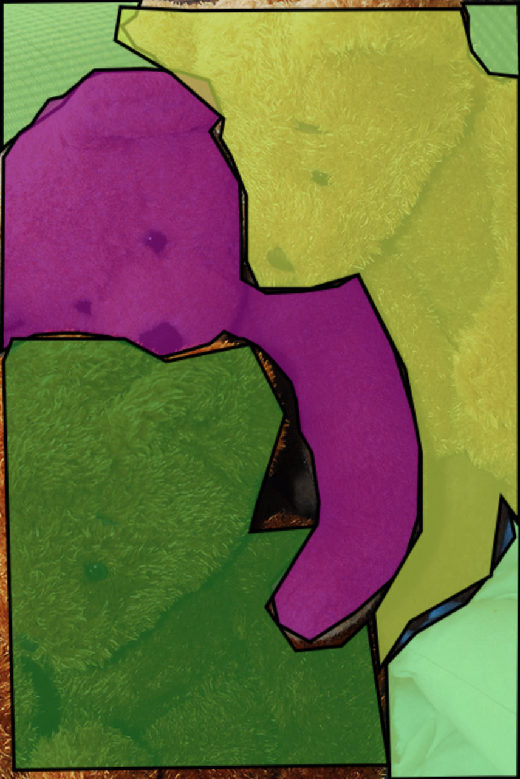
COCO
Annotations
bed
teddy bear
teddy bear
teddy bear
Notes:
Here’s the ground truth for the other image
It contains heavily overlapping object instances, each with its own segmentation mask
Note the occluded bed behind the teddy bears

Slide 7
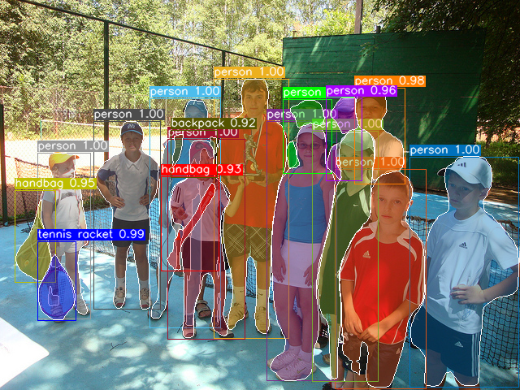
Example Mask R-CNN
Output on Unseen Images
Notes:
Here’s a validation image from the COCO dataset
I’m showing a visualization of the output of a state-of-the-art object detector called Mask R-CNN, which I’ll be telling you about today

Slide 8
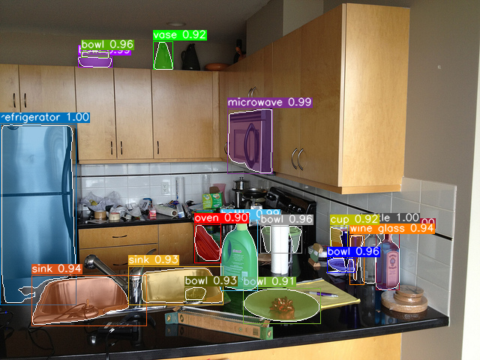
Example Mask R-CNN
Output on Unseen Images
Notes:
Here’s another example
By now you should have a flavor of the modern object detection problem
Given training images with annotations like the ones I was showing you, the goal is to design a model and an algorithm to fit the parameters of that model on the training data such that it generalizes well enough to outputs sensible detections on previously unseen images
So, well how do such systems work?

Slide 9
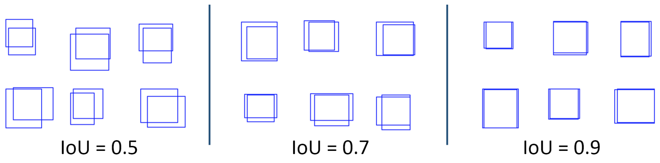
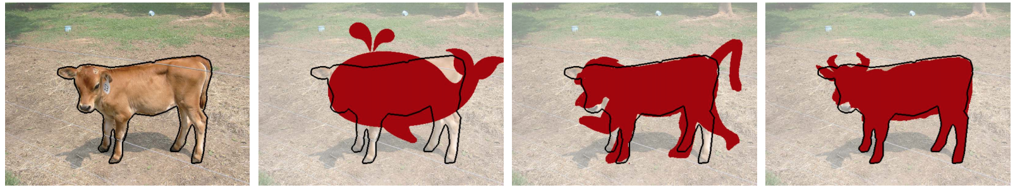
COCO Object Detection Average Precision (%)
Area under a detector’s precision-recall curve, averaged over…
Object categories
True positive overlap requirement (IoU from 0.5 to 0.95; see below)
boxes
masks
Ground truth
IoU = 0.55
IoU = 0.70
IoU = 0.91
Figure credits: Dollár and Zitnick (top), Krähenbühl and Kulton (bottom)
Notes:
To answer that question we can look at the quantitative results using the standard COCO metric of average precision
This is a percentage between 0 and 100, which 100 being best
It’s actually fairly complicated and has a lot of minor detections

Slide 10
COCO Object Detection Average Precision (%)
Past
(best circa
2012)
Early
2015
Late
2016
Today
2017
DPM
(Pre DL)
Fast R-CNN
(AlexNet)
Fast R-CNN
(VGG-16)
Faster R-CNN
(ResNet-50)
Faster R-CNN
(R-101-FPN)
Mask R-CNN
(X-101-FPN)
Felzenszwalb, Girshick, McAllester, Ramanan. Object Detection with Discriminatively Trained Part Based Models. PAMI 2010.
Notes:
The COCO dataset metrics were introduced in 2015
If we retrospectively took one of the best object detection systems from 2012, the deformable part model or DPM, it achieves about 5% AP on COCO

Slide 11
COCO Object Detection Average Precision (%)
Past
(best circa
2012)
Early
2015
Late
2016
Today
2017
Movement to
DL methods
DPM
(Pre DL)
Fast R-CNN
(AlexNet)
Fast R-CNN
(VGG-16)
Faster R-CNN
(ResNet-50)
Faster R-CNN
(R-101-FPN)
Mask R-CNN
(X-101-FPN)
Girshick. Fast R-CNN. ICCV 2015.
Notes:
The first generation deep learning systems, like R-CNN, weren’t scalable to be practical for COCO
If we look at the performance of Fast R-CNN, it fairs quite a bit better, tripling the DPM AP to 15
But this still sounds quite low

Slide 12
COCO Object Detection Average Precision (%)
Past
(best circa
2012)
Early
2015
Late
2016
Today
2017
DPM
(Pre DL)
Fast R-CNN
(AlexNet)
Fast R-CNN
(VGG-16)
Faster R-CNN
(ResNet-50)
Faster R-CNN
(R-101-FPN)
Mask R-CNN
(X-101-FPN)
Girshick. Fast R-CNN. ICCV 2015.
Notes:
But if we look at the developments we can see that progress didn’t saturate there

Slide 13
COCO Object Detection Average Precision (%)
Past
(best circa
2012)
Early
2015
Late
2016
Today
2017
DPM
(Pre DL)
Fast R-CNN
(AlexNet)
Fast R-CNN
(VGG-16)
Faster R-CNN
(ResNet-50)
Faster R-CNN
(R-101-FPN)
Mask R-CNN
(X-101-FPN)
Ren, He, Girshick, Sun. Faster R-CNN: Towards Real-Time Object Detection. NIPS 2015.
Notes:
In fact it keeps going

Slide 14
COCO Object Detection Average Precision (%)
Past
(best circa
2012)
Early
2015
Late
2016
Today
2017
DPM
(Pre DL)
Fast R-CNN
(AlexNet)
Fast R-CNN
(VGG-16)
Faster R-CNN
(ResNet-50)
Faster R-CNN
(R-101-FPN)
Mask R-CNN
(X-101-FPN)
Ren, He, Girshick, Sun. Faster R-CNN: Towards Real-Time Object Detection. NIPS 2015.
Notes:
And going

Slide 15
COCO Object Detection Average Precision (%)
Past
(best circa
2012)
Early
2015
Today
2017
DPM
(Pre DL)
Fast R-CNN
(AlexNet)
Fast R-CNN
(VGG-16)
Faster R-CNN
(ResNet-50)
Faster R-CNN
(R-101-FPN)
Mask R-CNN
(X-101-FPN)
Lin et al. Feature Pyramid Networks. CVPR 2017.
Notes:
And going

Slide 16
COCO Object Detection Average Precision (%)
Past
(best circa
2012)
Early
2015
Today
2017
DPM
(Pre DL)
Fast R-CNN
(AlexNet)
Fast R-CNN
(VGG-16)
Faster R-CNN
(ResNet-50)
Faster R-CNN
(R-101-FPN)
Mask R-CNN
(X-152-FPN)
He, Gkioxari, Dollár, Girshick. Mask R-CNN. ICCV 2017.
Notes:
And going
Now this chart is up to date as of last week when we submitted to the COCO challenge
This isn’t our final result, but our single best model is able to get 46 AP while running at 3 FPS on a PASCAL GPU

Slide 17
COCO Object Detection Average Precision (%)
Past
(best circa
2012)
Early
2015
2.5 years
Today
2017
Progress within
DL methods
DPM
(Pre DL)
Fast R-CNN
(AlexNet)
Fast R-CNN
(VGG-16)
Faster R-CNN
(ResNet-50)
Faster R-CNN
(R-101-FPN)
Mask R-CNN
(X-152-FPN)
Notes:
I’ve been showing a version of this slide since late 2013
Back then, the emphasis was on the dramatic improvement of the little curly brace
But now, with some years to look back on, what’s clearly more impressive is that progress didn’t and hasn’t yet plateaued
In fact the improvement within the set of deep learning methods has yet again tripled AP

Slide 18
1. What is this?
Past
(best circa
2012)
Early
2015
Today
2017
DPM
(Pre DL)
Fast R-CNN
(AlexNet)
Fast R-CNN
(VGG-16)
Faster R-CNN
(ResNet-50)
Faster R-CNN
(R-101-FPN)
Mask R-CNN
(X-152-FPN)
Notes:
So obviously I haven’t told you anything about these methods yet
I want to do three things in this talk
The first is to tell you about this far right method, Mask R-CNN

Slide 19
2. What made this possible?
Past
(best circa
2012)
Early
2015
2.5 years
Today
2017
Progress within
DL methods
DPM
(Pre DL)
Fast R-CNN
(AlexNet)
Fast R-CNN
(VGG-16)
Faster R-CNN
(ResNet-50)
Faster R-CNN
(R-101-FPN)
Mask R-CNN
(X-152-FPN)
Notes:
The second is to describe what I think are the factors that have made this improvement possible

Slide 20
3a. How good is this?
Past
(best circa
2012)
Early
2015
Today
2017
DPM
(Pre DL)
Fast R-CNN
(AlexNet)
Fast R-CNN
(VGG-16)
Faster R-CNN
(ResNet-50)
Faster R-CNN
(R-101-FPN)
Mask R-CNN
(X-152-FPN)
Notes:
I want to give you sense of how good this result is and show you why I think the problem isn’t solved yet

Slide 21
3b. What’s next?
Past
(best circa
2012)
Early
2015
Today
2017
?
DPM
(Pre DL)
Fast R-CNN
(AlexNet)
Fast R-CNN
(VGG-16)
Faster R-CNN
(ResNet-50)
Faster R-CNN
(R-101-FPN)
Mask R-CNN
(X-152-FPN)
Notes:
And finally, I’ll conclude with a few thoughts on what’s next for object detection research

